Slide 1
Capacity forecast on DALI data.
Spa
rk
Bram Vonk, JADS-Enexis
October 2021

Slide 2
Inhoud komend half uur
Resultaten sprint
Preprocess data (5 min)
Model tuning (10 min)
Visualisatie (10 min)
Werk komende sprint (5 min)

Slide 3
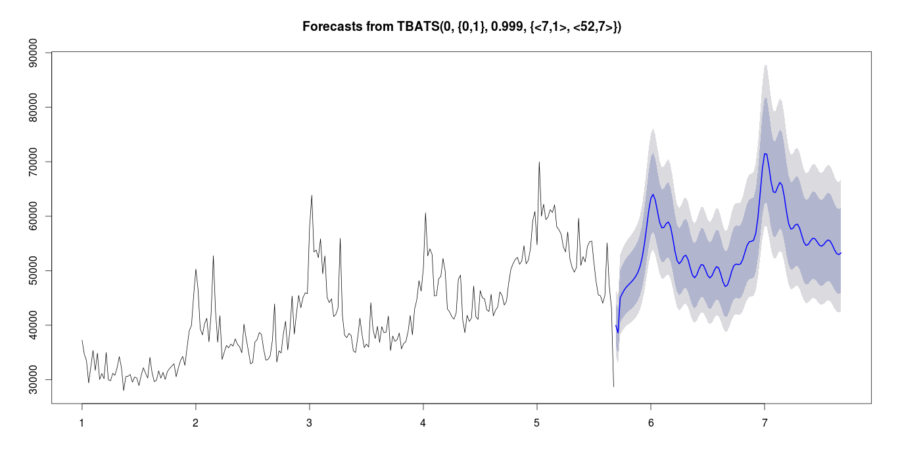
Recap vorige sprint
Project doel
Forecast 6-12 maanden vooruit de capaciteitsvraag op basis van DALI data.
Voorbeeld:
In de herfst kunnen bepalen met bepaalde zekerheid of er in de lente issues komen.
transformer limit
transformer
loading
autumn
spring
historic data
forecast

Slide 4
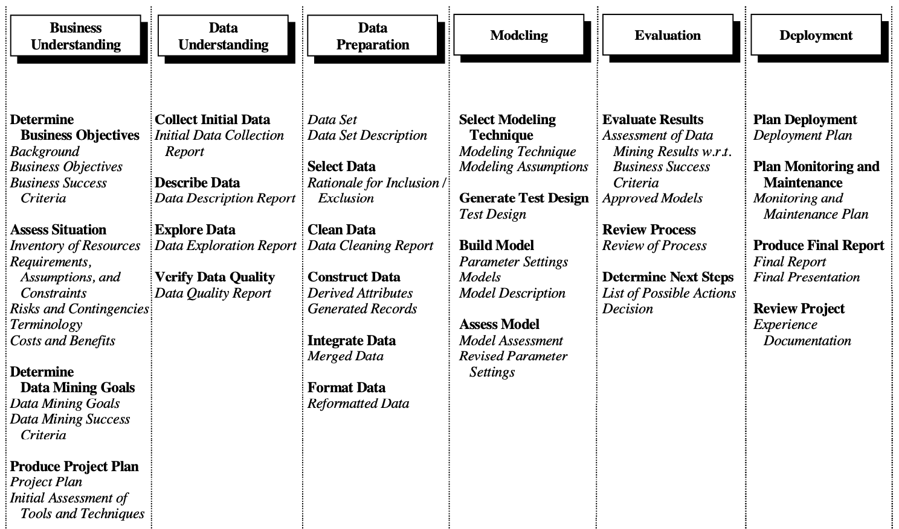
Focus afgelopen sprint (in september, na verlof)
Data Preparation
Verder met
Data Preparation → set op S3
Model → opzetten testcases
N.a.v. vorige review:
Zoek naar probleemgevallen
Bram vanuit de data
Netverantwoordelijken vanuit netkennis

Slide 5

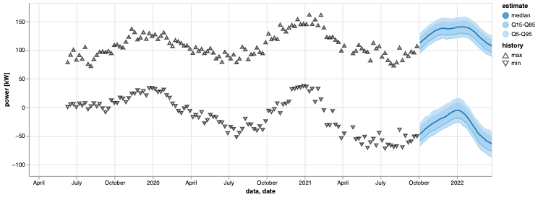

Algemene status
monthly / weekly
monthly
always
11k
10k
model
5
dashboard
weekly extremes
Vanuit Docker
Nog niet scheduled
Vanuit code (project)
Model trainen + forecast
Enkel opgeven DALI box ID
Vanuit code/notebook
DALI + forecast plot
Decompositie plots

Slide 6
Algemene status
monthly / weekly
monthly
always
model
dashboard
weekly extremes

Slide 7
start
get time last update
last update
<
last monday
no
yes
process
last update - last monday
weekly extremes
15 min averages
weekly
extremes
end

Slide 8
Preprocessing: filter op aantal DALI boxen
Alleen DALI boxen met metadata
10.092 / 10.992 heeft metadata
(Voorlopig) alleen boxen met:
>2 jaar data (na strippen init. nullen)
max belasing >50% trafo
Vraag: Is bovenstaande OK?

Slide 9
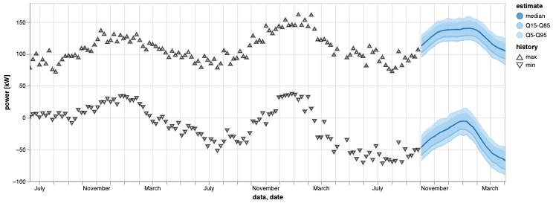
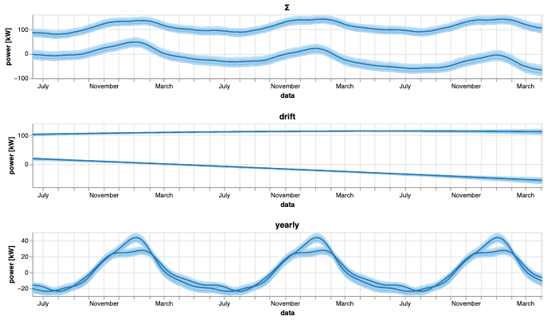
Modellering
Algemeen
Additief model (drift + yearly)
Stabiel, maar vangt groei moeilijk
Multiplicatief model instabiel → hybride?
Trend moeilijk te fitten
Exponentiele fit instabiel→polynoom
Veel afwijking bij extrapolatie→weights
Robuust tegen outliers

Slide 10
Modellering: Ideeën ter verbetering (op prio)
Meer gewicht aan recentere DALI data geven voor trainen model
Via pm.Potential
Via pm.<distributio(tau=weights)
Hybride model additiief/multiplicatief
Ipv drift + yealry of drift * yearly → c * drift + (1-c) * yearly + yearly ?
Prior seasonality uit pool gebruiken voor recent neergehangen boxen
Omschakelen net detecteren d.m.v. blok signaal als extra component.
Robuustness tegen outliers verbeteren (PYMC3 voorbeeld)

Slide 11
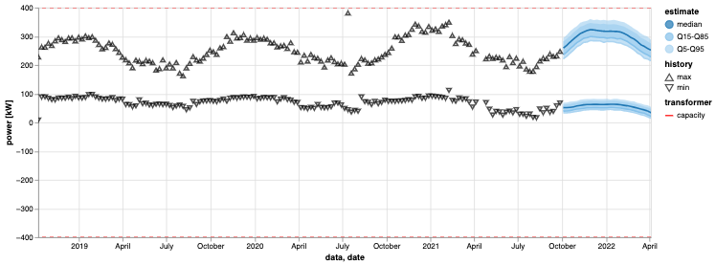
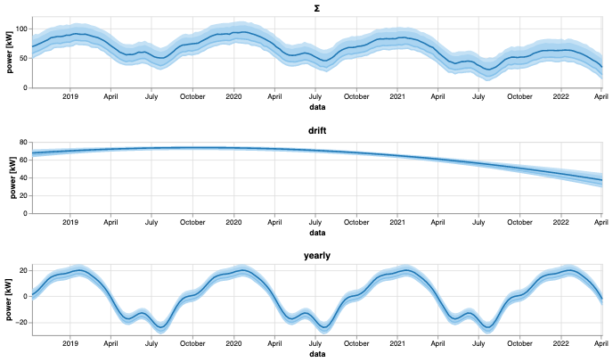
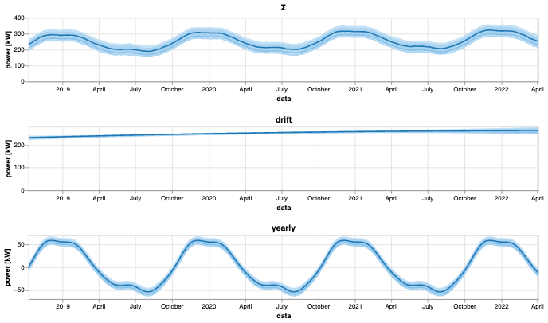
Plots

Slide 12
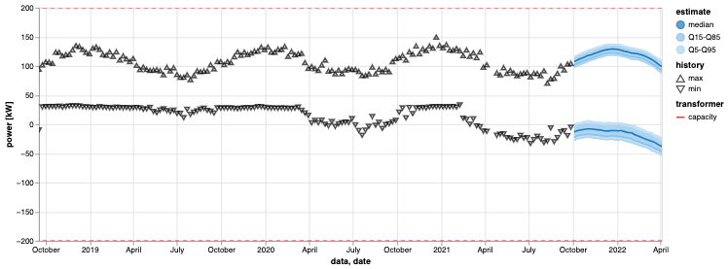
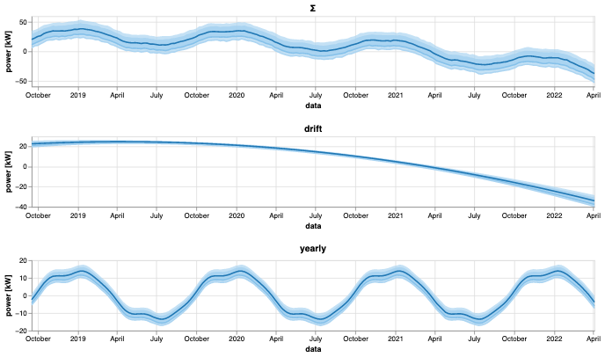
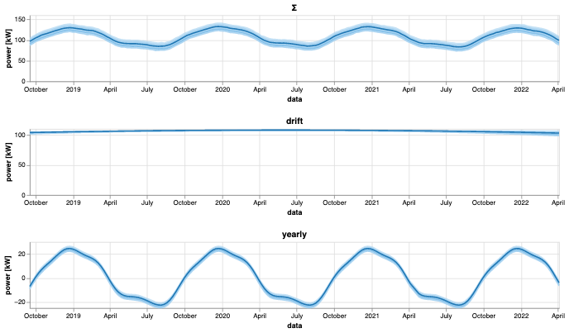
Plots

Slide 13
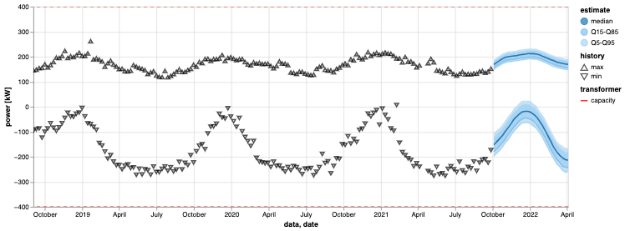
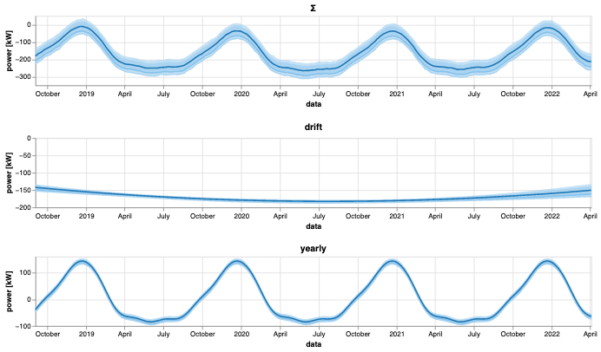
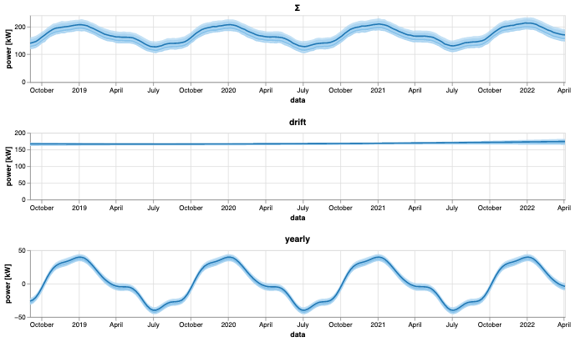
Plots

Slide 14
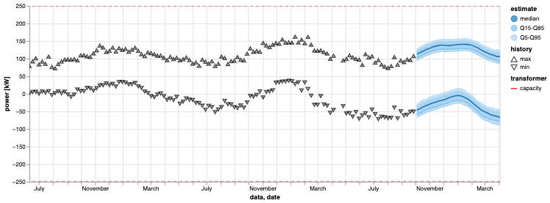
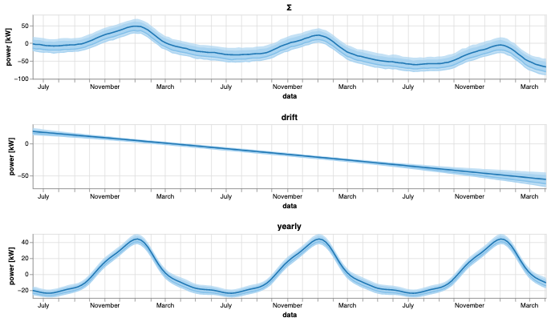
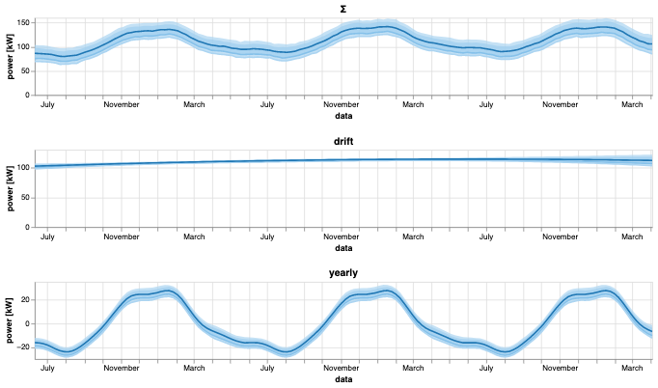
Plots

Slide 15
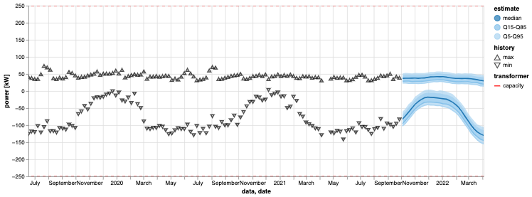
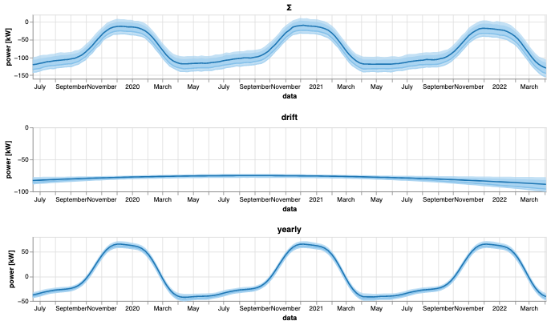
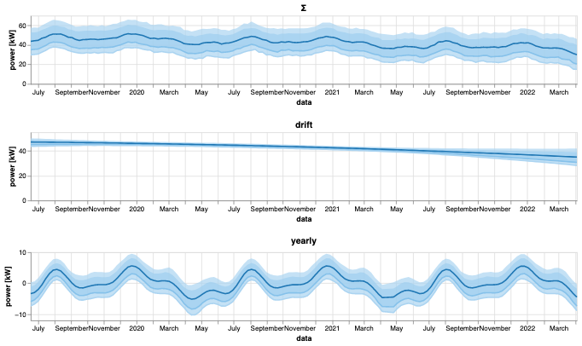
Plots

Slide 16
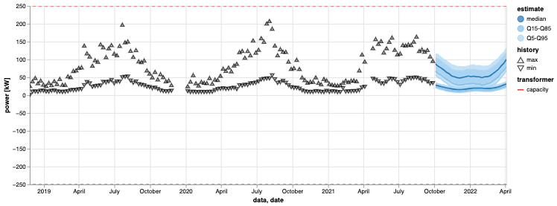
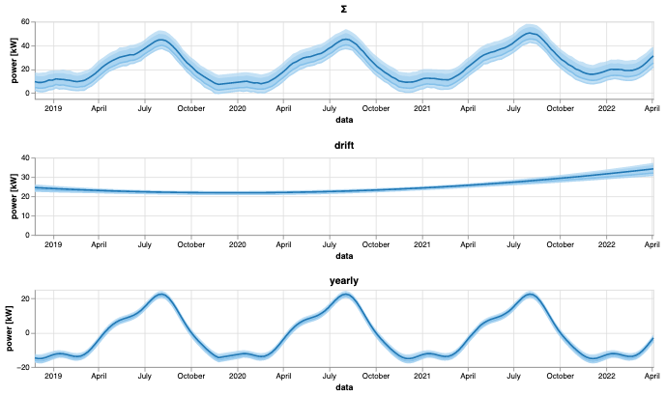
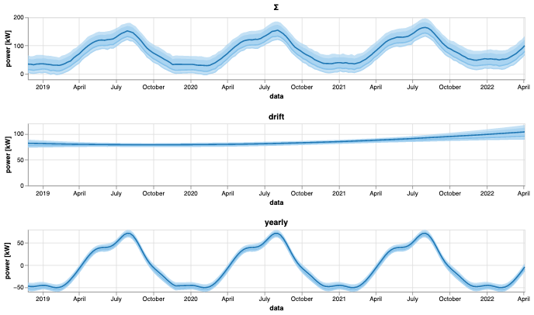
Plots

Slide 17
Visualisaties
Plots
Helder?
Wat mis je?
Decompositie handig?
Interactiviteit?
Verder:
Welke Quantilen gewenst?
Hoe ordenen van boxsignalen?
Band?
Tijd?
Capaciteit trafo aanhouden?

Slide 18

Werk komende sprint : backlog
Business Understanding
Data Understanding
Data Preparation
Modeling
Evaluation
Deployment
Transfer code to functions
Write forecast quantiles in DB
Backcast function for evaluation
Reusable plot function
order / priority
Model trend exponential function
Determine GUI with business
Run for all boxes
Assess results with business
Scheduled train + forecast
24/7 accessible tool
Setup task for every month
Dashboard results online
Scheduled data preprocessing
Deal with switch action in model
Atrtappen via Docker
Documentation online
Sorting algorithm for priority
Detect max date specific week
Setup task for every week
Overload signaling
Export data for grid planning
Model improvement (x times)
Shortcut to meetdata dashboard

Slide 19
Way of Working vanuit Data Science/JADS: CRISP-DM
Business Understanding
Data Understanding
Data Preparation
Modeling
Evaluation
Deployment

Slide 20
Flow Down Business value
Business Value
Safety
Reliability
Affordability
Sustainability
Company KPI
Overloading
Outage
Claims
Ad hoc resources
Planned resources
Project KPI
Do nothing
Ad hoc replacement
Stop growth
Planned replacement
Possible actions
Optimal planning transformer replacement
Model Usage
Forecast Model
Transformer overloaded soon
Model result
Future timeseries P / S DALI
Y variables
Nominal power of transformer
Historic timeseries P / S DALI
X Variables

Slide 21
Requirements for achieving value
Model
Explainable
Forecast has prediction intervals
Forecast horizon 6-12 months
Uses prior information of population (if data is limited)
Usage tool
No separate log in/install
Quick visualisation of results (no waiting)
Scalable up to 35k transformers
Sorting on urgency
Reliable (tool + forecast)
Export results possible for other tools (e.g. Vision, Power BI dashboards)

